Slide 1
Introduction to Compiler Phases

Slide 2
Why Use a compiler?
Compiler is a program which takes one language as input and translate it into an equivalent another language.
Compiler is divided into two parts: Analysis and Synthesis
This is
a program
10000010010110100100101……

Slide 3
Phases Of Compiler

Slide 4
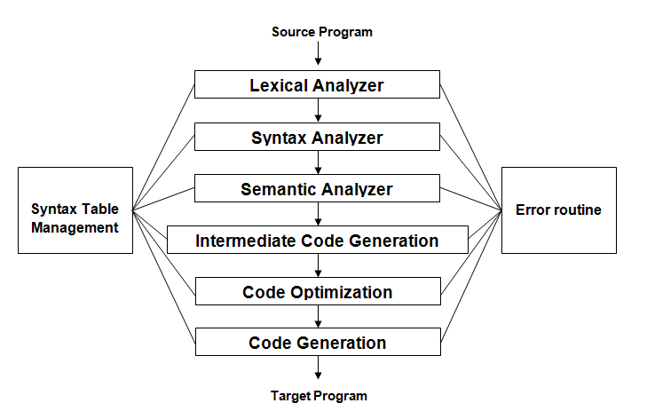

Slide 5
Phases of Compilers
Consider the following example:
percent_profit = (profit * 100) / cost_price
Lexical units identifies =, * and / operators, 100 as constant, and the remaining strings as identifiers.
Syntax analysis identifies the statement as an assignment statement with percent_profit as the left hand side and (profit * 100) / cost_price as the expression on the right hand side.
Semantic analysis determines the meaning of the statement to be the assignment of profit * 100 / cost_price to percent_profit.

Slide 6
Phases of Compilers
Synthesis Phase
The synthesis phase is concerned with the construction of target language statements which have the same meaning as a source statement.
It performs two main activities:
Creation of data structures in the target program (memory allocation)
Generation of target code (code generation)

Slide 7
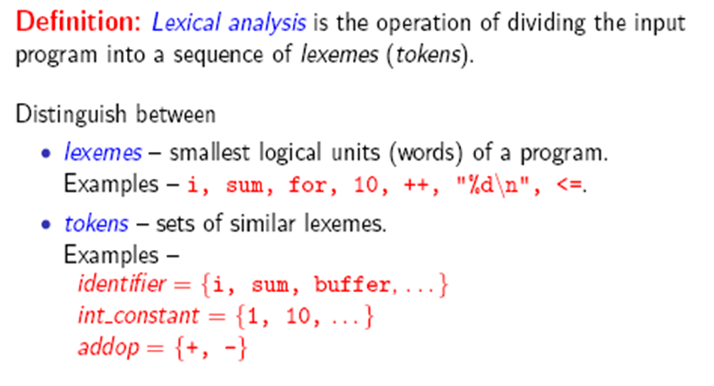
Phase-1: Lexical Analysis

Slide 8
Example:
newval := oldval + 12
Tokens:
newval Identifier
= Assignment operator
oldval Identifier
+ Add operator
12 Number (Constant)
Lexical analyzer truncates white spaces and also removes errors.

Slide 10
Phase-2: Syntax Analysis
Also called Parsing or Tokenizing.
The parser uses the first components of the tokens produced by the lexical analyzer to create a tree-like intermediate representation that depicts the grammatical structure of the token stream.
A typical representation is a syntax tree in which each interior node represents an operation and the children of the node represent the arguments of the operation

Slide 11
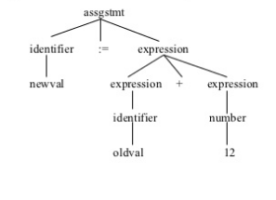
Example:

Slide 12
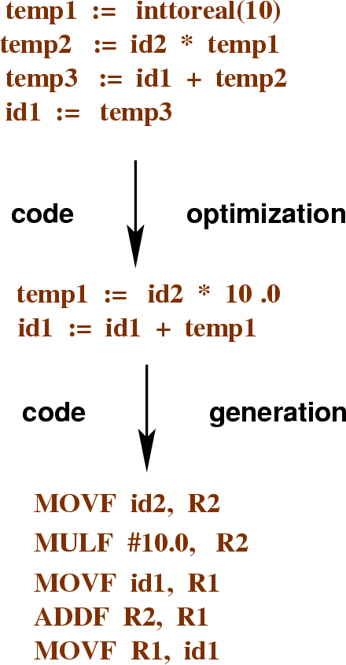
The Analysis-Synthesis Model

Slide 13
Phase-3: Semantic Analysis
The semantic analyzer uses the syntax tree and the information in the symbol table to check the source program for semantic consistency with the language definition.
An important part of semantic analysis is type checking, where the compiler checks that each operator has matching operands.
For example, many programming language definitions require an array index to be an integer; the compiler must report an error if a floating-point number is used to index an array.
Example: newval := oldval+12

Slide 14
Example:
Semantic analysis
Syntactically correct, but semantically incorrect example:
sum = a + b;
int a; double sum; data type mismatch char b;
Semantic records
a integer
sum double
b char

Slide 15
Example:
newval := oldval + fact * 1
Id1 := Id2 + Id3 * 1
Temp1 = int to real (1)
Temp2 = Id3 * Temp1
Temp3 = Id2 + Temp2
Id1 = Temp3

Slide 16
Phase-4: Intermediate Code Generation
After syntax and semantic analysis of the source program, many compilers generate an explicit low-level or machine-like intermediate representation (a program for an abstract machine). This intermediate representation should have two important properties:
it should be easy to produce and
it should be easy to translate into the target machine.
The considered intermediate form called three-address code, which consists of a sequence of assembly-like instructions with three operands per instruction. Each operand can act like a register.
This phase bridges the analysis and synthesis phases of translation.

Slide 17
Example:
newval := oldval + fact * 1
Id1 := Id2 + Id3 * 1
Temp1 = into real (1)
Temp2 = Id3 * Temp1
Temp3 = Id2 + Temp2
Id1 = Temp3

Slide 18
Phase 5 : Code Optimization
The above intermediate code will be optimized as:
Temp1 = Id3 * 1
Id1 = Id2 + Temp1

Slide 19
Phase-6: Code Generation
The last phase of translation is code generation.
Takes as input an intermediate representation of the source program and maps it into the target language
If the target language is machine, code, registers or memory locations are selected for each of the variables used by the program.
Then, the intermediate instructions are translated into sequences of machine instructions that perform the same task.
A crucial aspect of code generation is the judicious assignment of registers to hold variables.

Slide 20
Example:
Id1 := Id2 + Id3 * 1
MOV R1,Id3
MUL R1,#1
MOV R2,Id2
ADD R1,R2
MOV Id1,R1

Slide 21
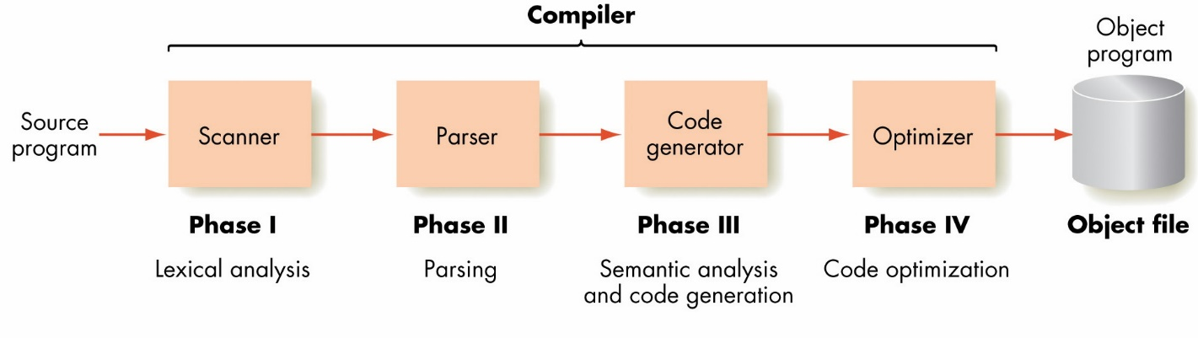

Slide 22
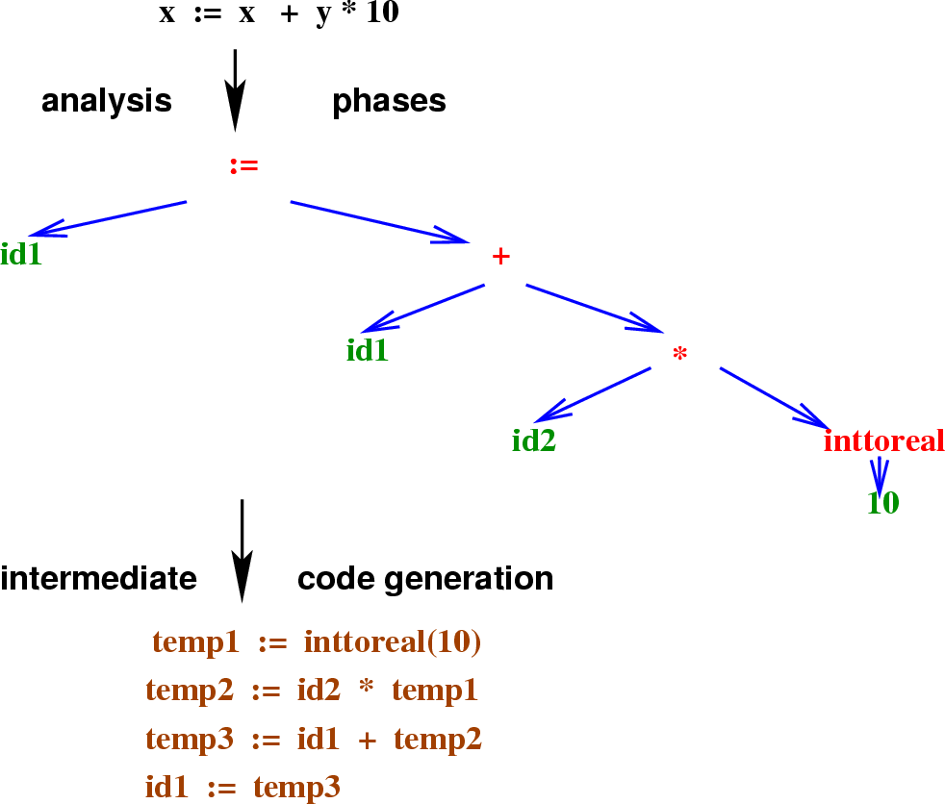
The Analysis-Synthesis Model

Slide 23
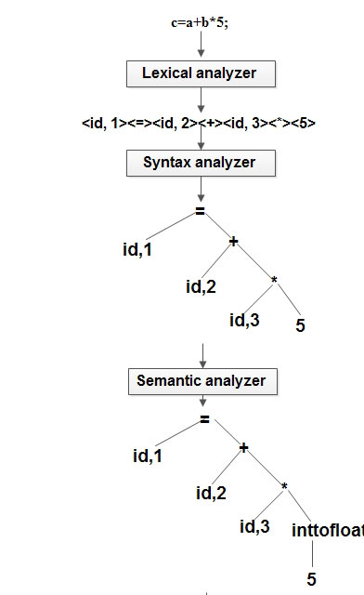
Example
(c=a+b*5)

Slide 24

Types of Compiler
Native Compiler
Cross Compiler
Compilers-Compiler
Transpiler

Slide 25
Cross Compiler
A compiler that runs on one computer platform and produces code for another is called as
“Cross compiler”.
A compiler produces a series of files called as object files.

Slide 26
COMPLIERS vs. CROSS COMPLIERS
Compiler
Cross Compiler
Uses OS as
Platform
Uses OS as
Platform
Edit the program
Compilation
Edit the program
Compilation
Running /
Execution
4. Output
Uses 2nd platform
ie hardware
Execution and output

Slide 27
Compiler-Compiler
It is a Compiler Generator
It Generates the Compiler for a Programming Language defined by attribute grammar.
Language to compile itself is the essence of bootstrapping.
Notes:
Bootstrapping may arise the question, “How was the First compiler compiled?” which sounds like “what came first, chicken or Egg?”

Slide 28
Uses of cross compiler
Embedded computers where a device has extremely limited resources.
Compiling for multiple machines. For example, a company may wish to support several different versions of an operating system or to support several different operating systems.
Notes:
Embedded computers where a device has extremely limited resources. For example, a microwave oven will have an extremely small computer to read its touchpad and door sensor, provide output to a digital display and speaker, and to control the machinery for cooking food. This computer will not be powerful enough to run a compiler, a file system, or a development environment. Since debugging and testing may also require more resources than are available on an embedded system, cross-compilation can be less involved and less prone to errors than native compilation.
Compiling for multiple machines. For example, a company may wish to support several different versions of an operating system or to support several different operating systems. By using a cross compiler, a single build environment can be set up to compile for each of these targets.

Slide 29
Transpiler
A source-to-source Compiler, transcompiler or transpiler is a type of compiler that takes the source code of a program written in one programming language as its input and produces the equivalent source code in another programming language.
For example, a source-to-source compiler may perform a translation of a program from Pascal to C

Slide 30
Interpreter
An interpreter is another common kind of language processor. Instead of producing a target program as a translation, an interpreter appears to directly execute the operations specified in the source program or inputs supplied by the user
The machine-language target program produced by a compiler is usually much faster than an interpreter at mapping inputs to outputs . An interpreter, however, can usually give better error diagnostics than a compiler, because it executes the source program statement by statement.
Source
Program
Interpreter
Output
Input
Error messages

Slide 31
 | Compiler | Interpreter
Scanning | Compiler scans the entire program first and then translates into machine code. | Interpreter scans and translates the program line by line to equivalent machine code.
Error Report | Compiler gives you list of all errors after compilation of whole program. | Interpreter stops the translation at the error generation and will continue when error get solved.
Machine code | Compiler converts the entire program to the machine code when all the errors are removed, executiontakes place. | Each time the program is executed; every line is check for error and then converted into equivalent machine code.
Debugging | Compiler is slow for debugging. | Interpreter is good for fast debugging.
Execution Time | Compiler takes less execution time. | Interpreter takes more execution time.
Speed | Compiler is faster. | Interpreter is slower in compare to compiler.
After Modification | If you make any modification in program you have to recompile entire program i.e. scan the whole program every time after modification. | If you make any modification and if that line has not been scanned then no need to recompile entire program.

Slide 32
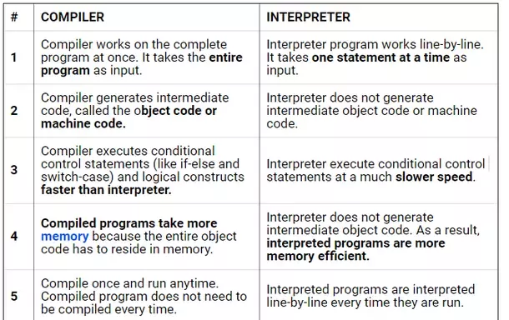

Slide 33
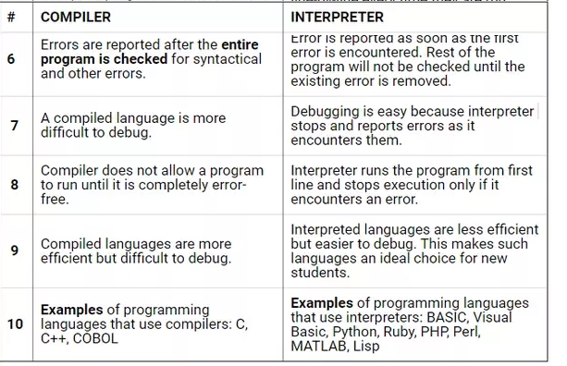

Slide 34
Working Process of Compilers Vs Interpreter
Compilation Process:
Interpretive Process:
Data
Source
program
Object
program
Results
Compiler
Executing
Computer
Compile time
Run time
Data
Source
program
Interpreter
Result

Slide 35
Summary
Compiler front-end: lexical analysis, syntax analysis, semantic analysis
– Tasks: understanding the source code, making sure the source code is written correctly
• Compiler back-end: Intermediate code generation/improvement, and Machine code generation/improvement
– Tasks: translating the program to a semantically the same program (in a different language).

Slide 36
THANK YOU

